Slide 1
The Grassland Plant Survey

Slide 2
Key vocabulary
Habitat | The place where an animal, plant or other organism lives
Quadrat | A frame which gives us our area to survey
Indicator plant | A plant that tells us information about its environment depending on whether we find it or not
Calcareous grassland | Grassland growing on alkaline soils derived from limestone or chalk bedrock

Slide 3
Why do we survey the plants in a habitat?

Slide 4
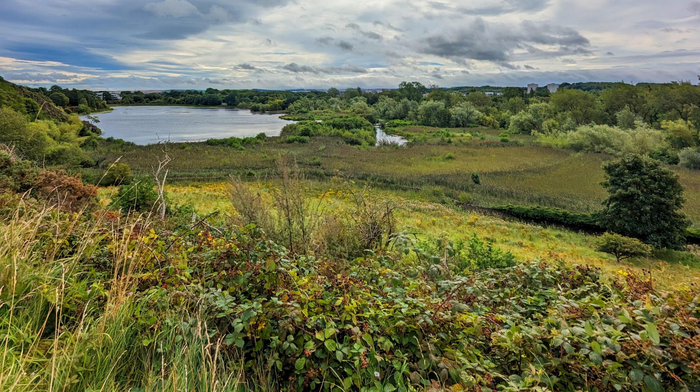
Divide this image into different habitats

Slide 5
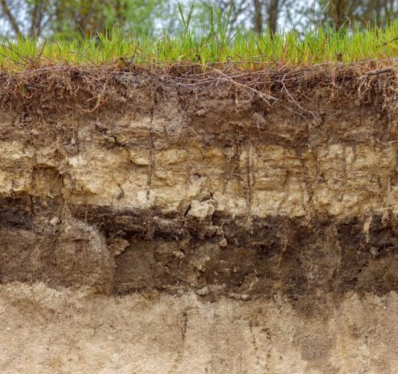
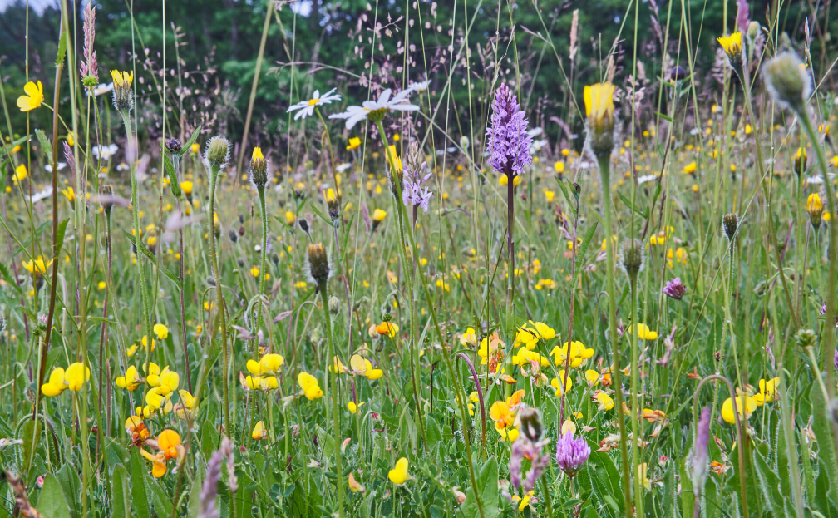
What factors did you use to differentiate habitats?
Plants can be used to tell us a lot about an ecosystem such as:
soil qualities biodiversity

Slide 6
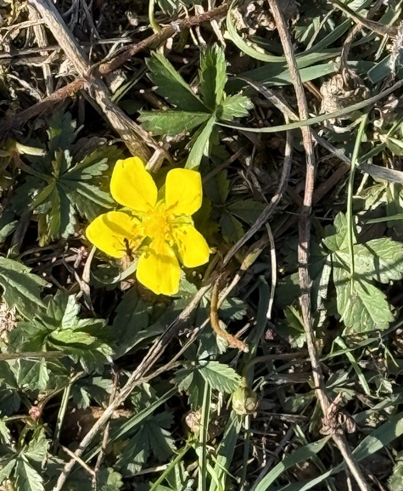
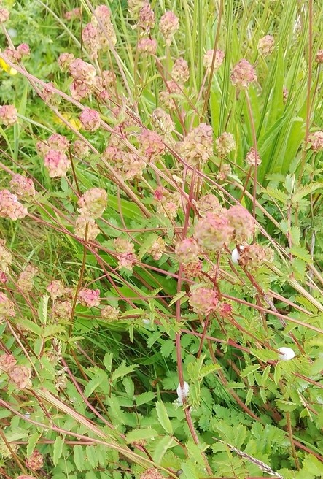
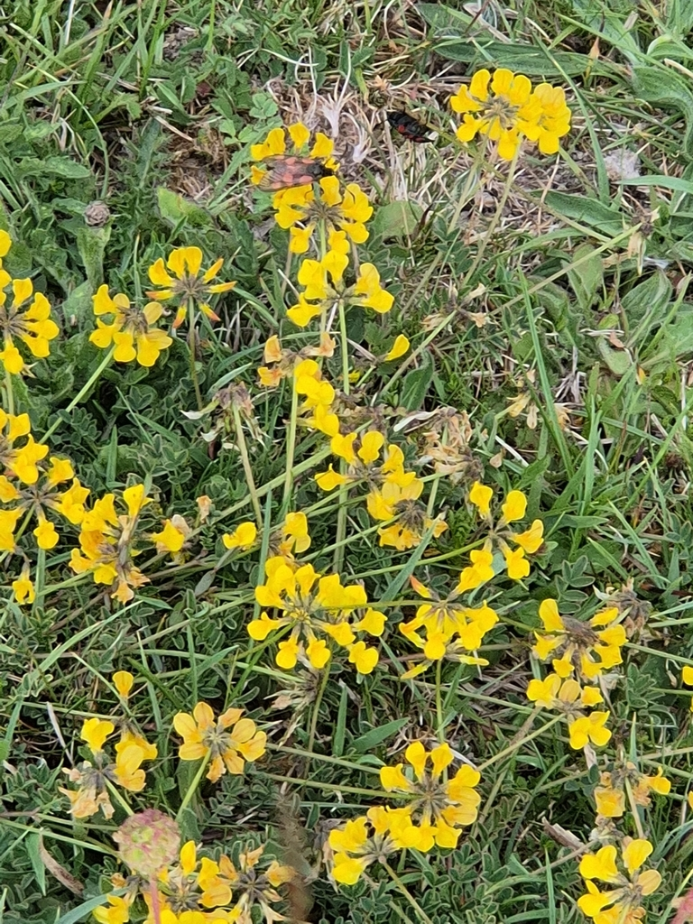
Example
Plants
indicate calcareous grassland,
an uncommon habitat that is home to many specialist animals.
cinquefoils
salad burnet
horseshoe vetch
Notes:
Calcareous grassland forms on top of chalk.
Soils tend to be thin and quick-draining, but the soil chemistry and structure support a variety of specialist plants.
Chalk dissolves relatively easily, so mineral nutrients are rapidly replenished.
Home to many snail species, including many which do not live in other habitats because there is not enough available calcium.
Also home to the Adonis blue butterfly, which relies on horseshoe vetch as a food plant. Horseshoe vetch needs chalk or limestone-based soils to grow well.

Slide 7
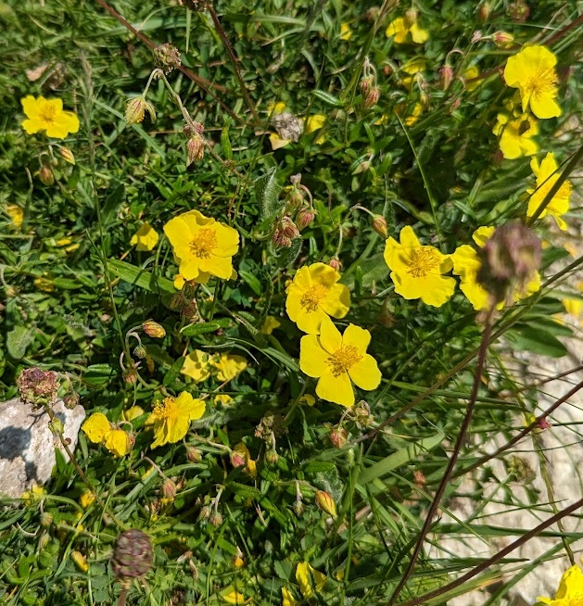
Notes:
Here are all three plants in the same picture

Slide 8
The Grassland Plant Survey

Slide 9
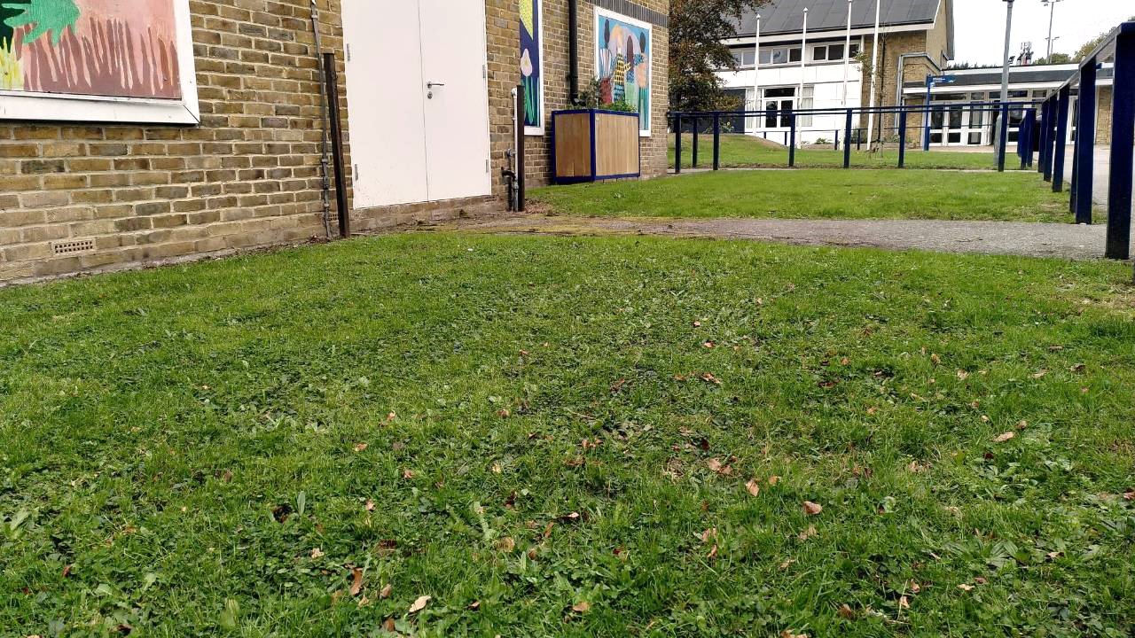
Are all grass habitats the same?

Slide 10
What types of grassland do we have here?
We need to survey what plants are growing in the grass.

Slide 11
Why are we looking at grass at school?
Dr Victoria Burton, a researcher working on Nature Park, says,
"Grasslands are the largest green habitat on most school grounds, but they don’t all support the same variety of plants. A playing field or lawn might have just one species per square metre, while a meadow can have more than fifteen. By looking closely, you can uncover what’s growing in your own grasslands and spot how it’s changing over time."

Slide 12
A team effort
schools up and down the country can all get involved in the same survey that we are doing
everyone is working together to learn about the state of grassy areas in schools across the country
this means we can learn how much biodiversity grassy areas in schools are supporting
we are all community scientists by getting involved!!

Slide 13

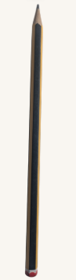
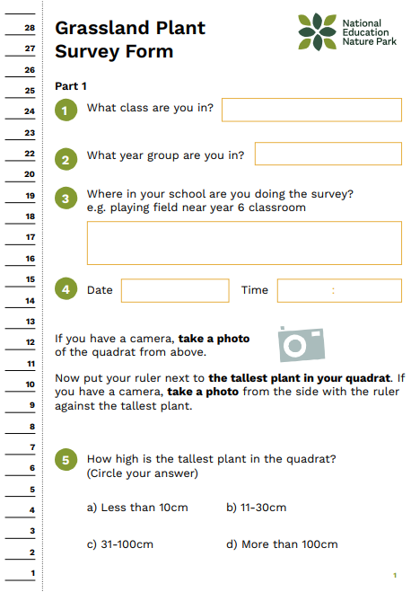

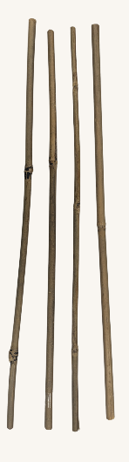
Equipment
tools for making 50cm x 50cm quadrat
clipboard pencil survey form blank paper

Slide 14
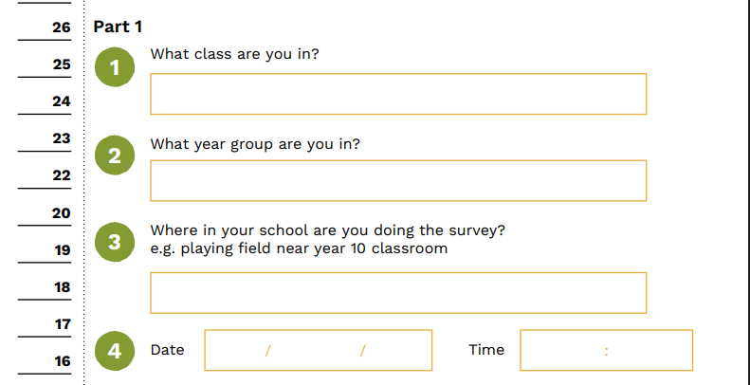
Part 1 of the survey
You will write down:
your class and year group
where in school you are doing the survey
the date and time
Notes:
Discuss part 1 of the survey.
Part 1 continues on the next slides

Slide 15
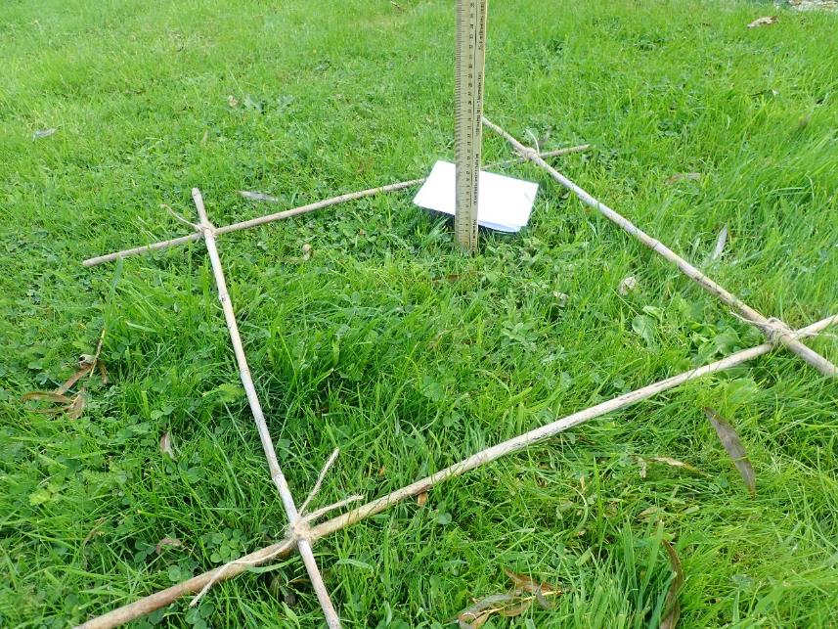
You will then:
take a photo of your quadrat from above and from the side
measure the height of the tallest plant in your quadrat
Notes:
The photos are not required so if you don't have a camera then you can remove that sentence from the slide. In the survey form it ask you to take a photo only if you have a camera.

Slide 16
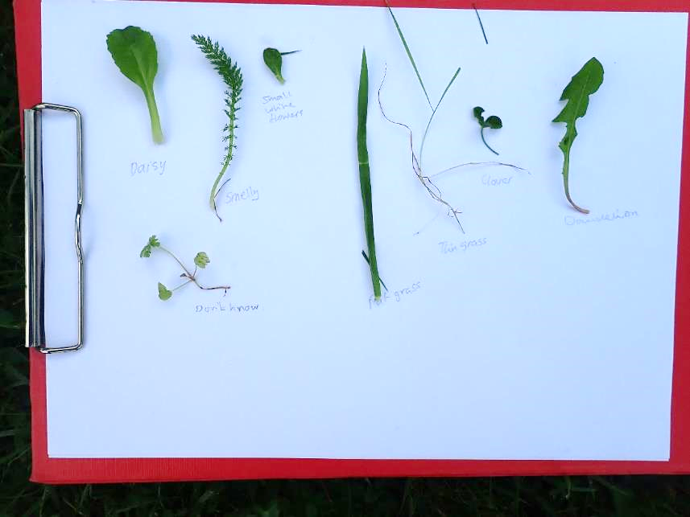
You will then:
count how many different types of plant are living inside your quadrat
pick a leaf from each type of living plant. Put them on a piece of paper and take a photo.
Dead leaves do not count!

Slide 17
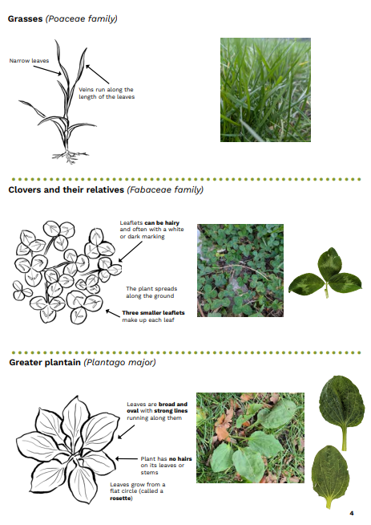
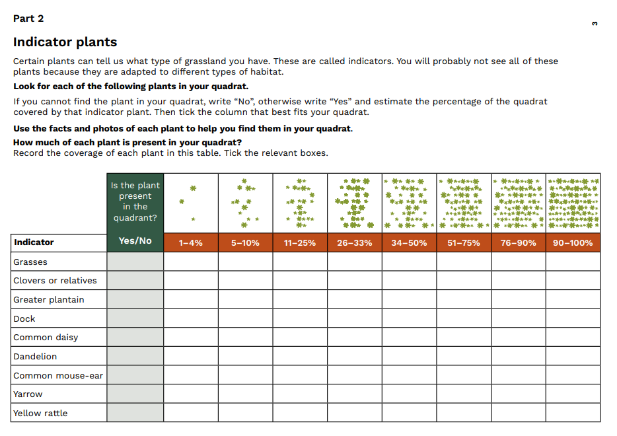
Part 2
You will:
look for different indicator plants inside your quadrat
for each indicator, write whether you find them in your quadrat or not
for each one you find write the percentage of the space inside the quadrat that it covers
Notes:
Remind them that it is not about finding all the indicators

Slide 18
What indicators are we looking for?

Slide 19
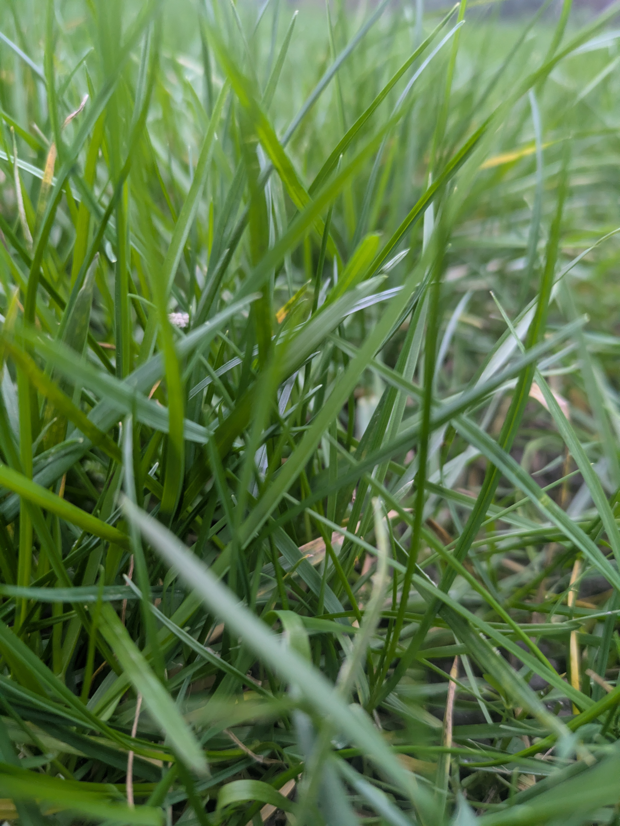
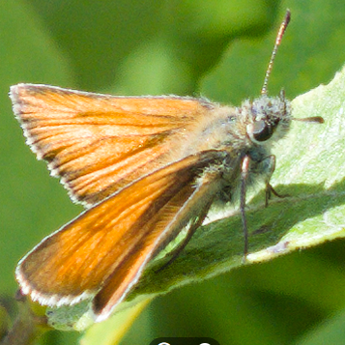
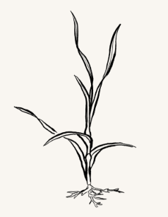
Grasses
Meet the insect
The caterpillars of the Small skipper butterfly feed almost exclusively on a few different grasses.
Fun fact
Many grasses are wind pollinated. This means that their pollen is carried and spread by wind.

Slide 20
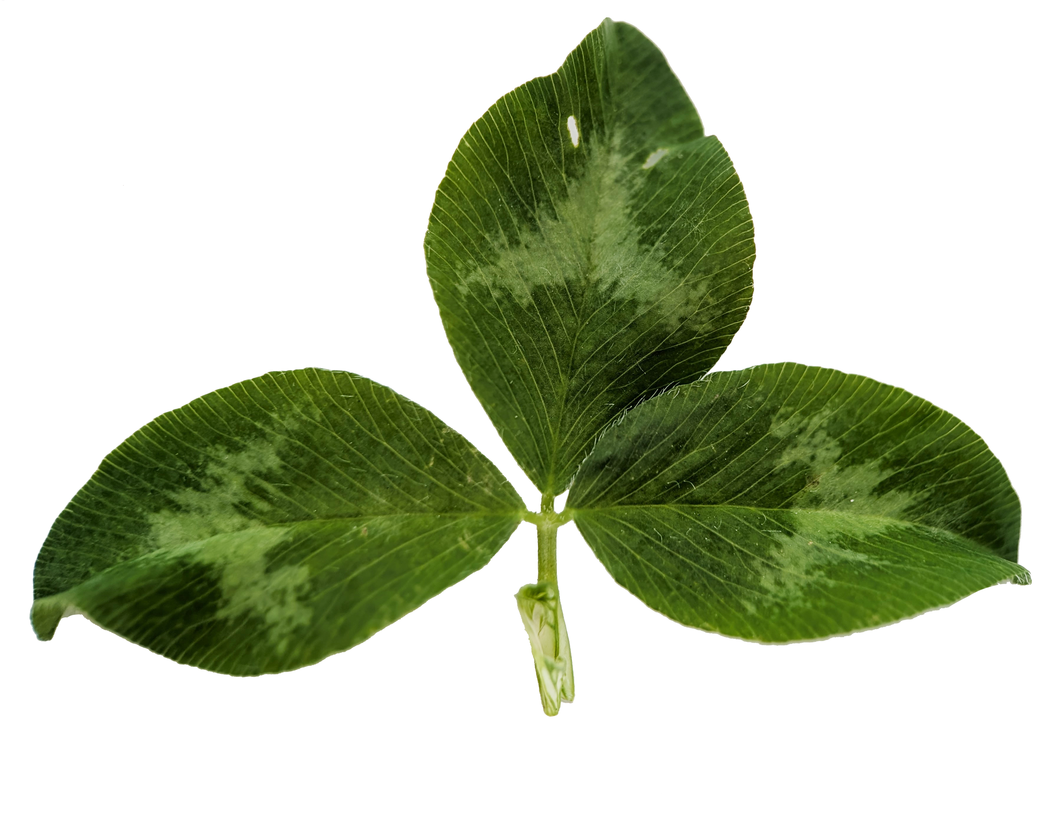
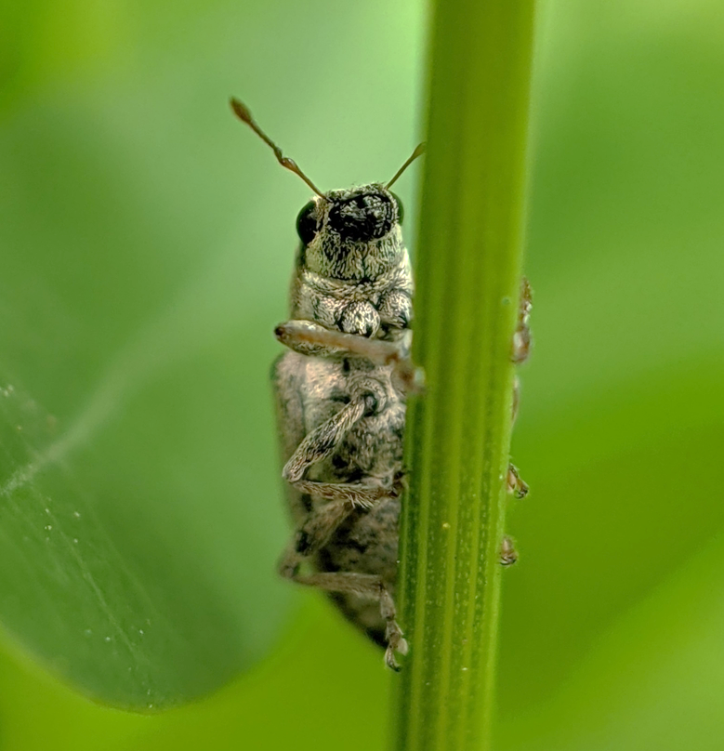
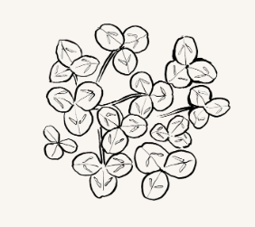
Clovers and their relatives
Fun fact
They increase the amount of nitrogen in the soil via nodules on their roots. These nodules house bacteria which take in nitrogen in the air and change it into forms plants can use.
Meet the insect
Pea weevils are small beetles that depend on clovers for food. Their young live underground and eat the roots of clovers and their relatives.

Slide 21
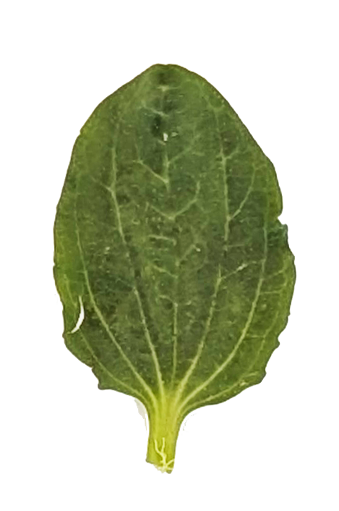
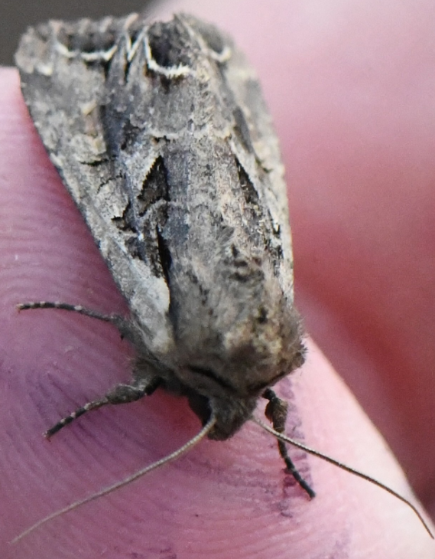

Greater plantain
Meet the insect
The caterpillars of the Dog's Tooth moth feed on Greater plantain.
Fun fact
The leaves and stalks are connected by strong elastic fibres.
It is known by some Native Americans as 'White man's footprint', because it was introduced by European settlers.

Slide 22
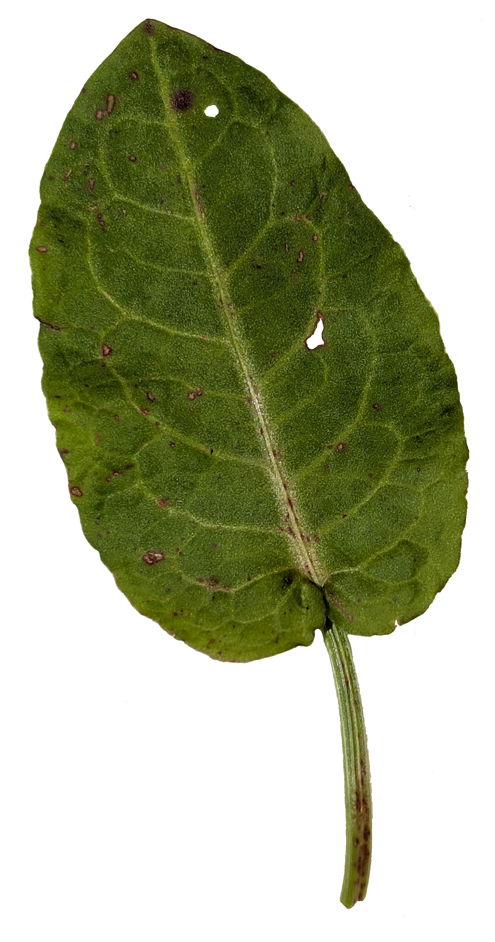
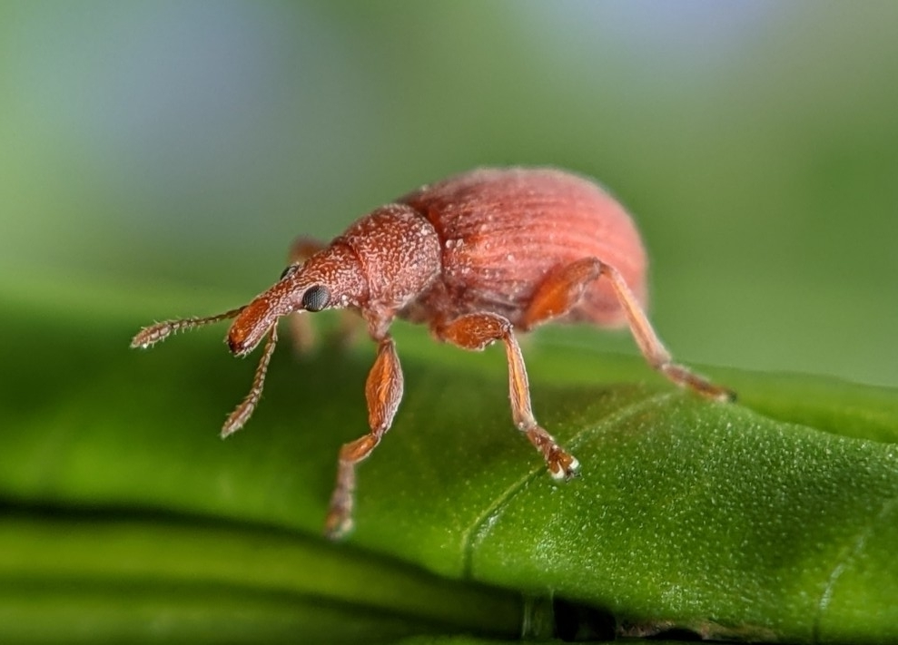
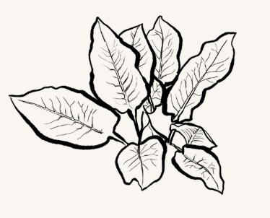
Dock
Meet the insect
Dock weevil larvae tunnel through plant stems and leaf stalks in dock plants. The adults can be seen walking on leaves and stems eating the plant, but they drop to the ground quickly when bothered.
Fun fact
There are 34 different insect species in the UK that feed on docks e.g. Small copper butterfly caterpillar.
Dock seeds can survive in the soil for up to 50 years.

Slide 23
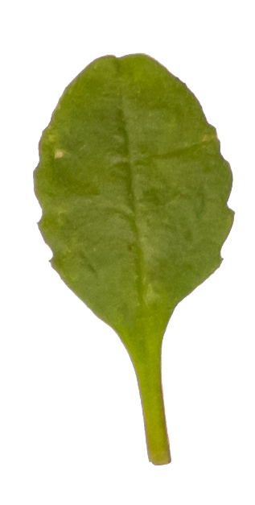
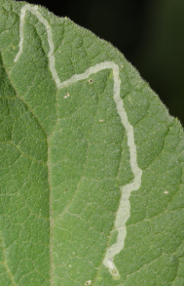

Common daisy
Meet the insect
The larval stage of the Chrysanthemum leafminer particularly likes the leaves of daisies.
Fun fact
Daisy flowers open in the morning and close at night.
Each daisy is not just one flower but made up of hundreds of tiny flowers.

Slide 24
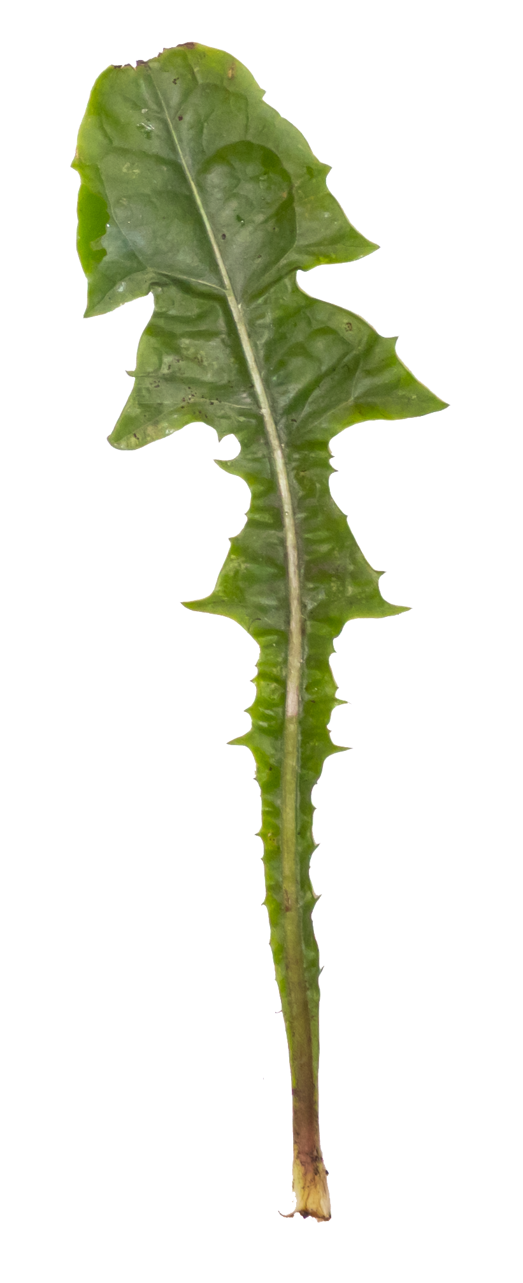
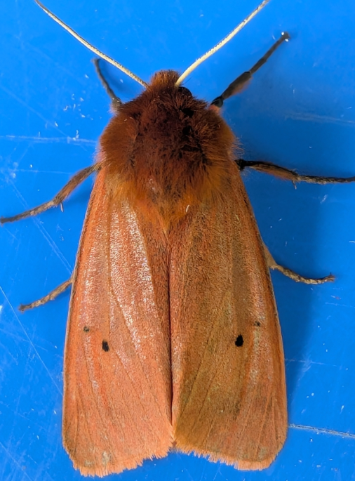
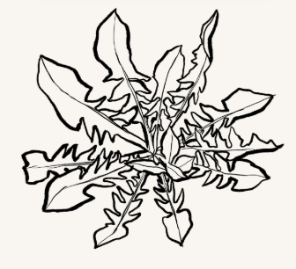
Dandelion
Meet the insect
The caterpillars of the Ruby Tiger moth love munching on Dandelions.
Fun fact
Dandelion sap can be used to make a type of rubber.
They are over 200 species of Dandelion in the UK!!

Slide 25
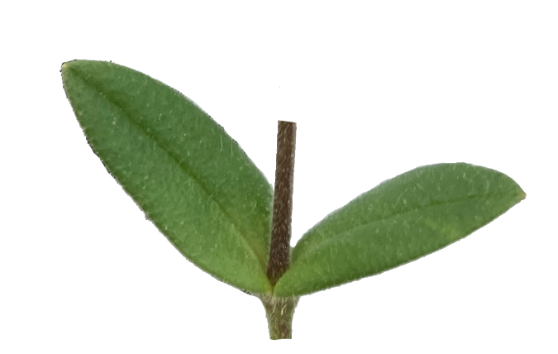
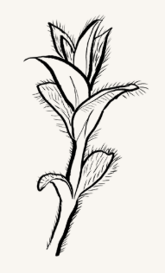
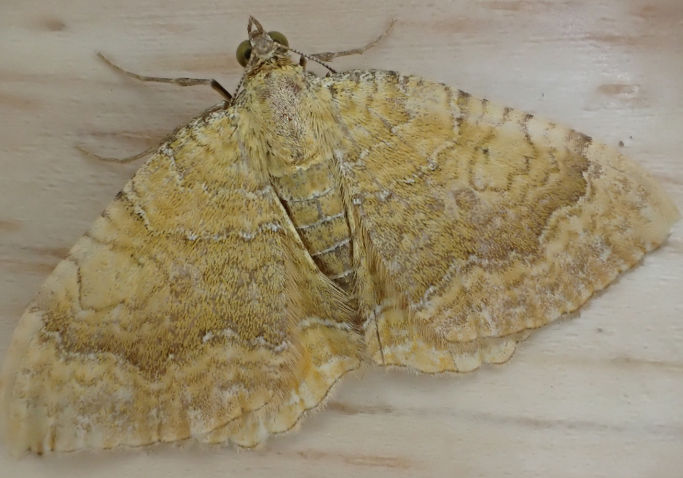
Common mouse-ear
Meet the insect
The caterpillar of the Yellow Shell moth loves to feed on Common mouse ear and other chickweeds.
Fun fact
The seed is very long-lived,
surviving buried for up to 40
years.

Slide 26
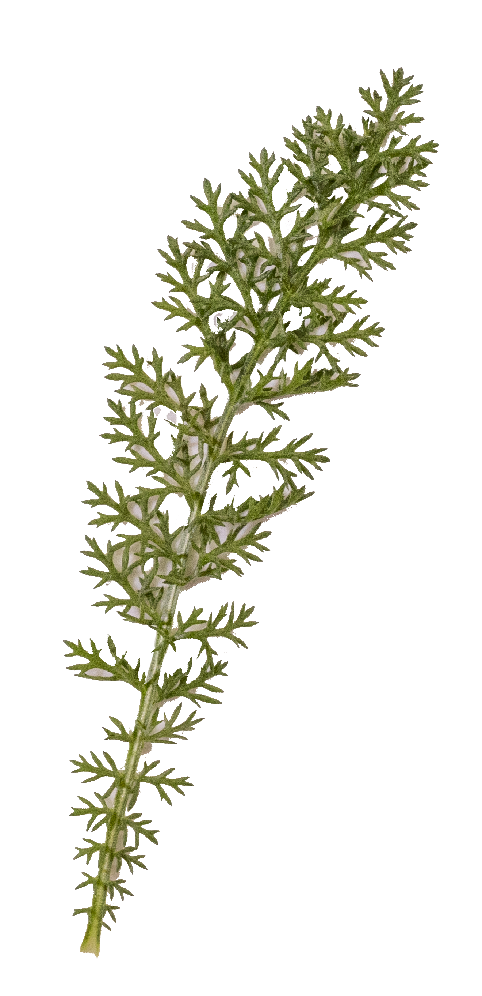
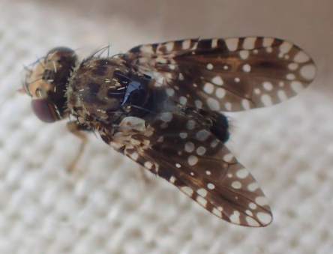
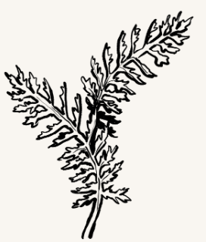
Yarrow
Fun fact
When crushed, Yarrow leaves smell like herbs.
Starlings line their nests with Yarrow leaves to deter insects.
Meet the insect
The Mottled Yarrow fly depends heavily on Yarrow.

Slide 27
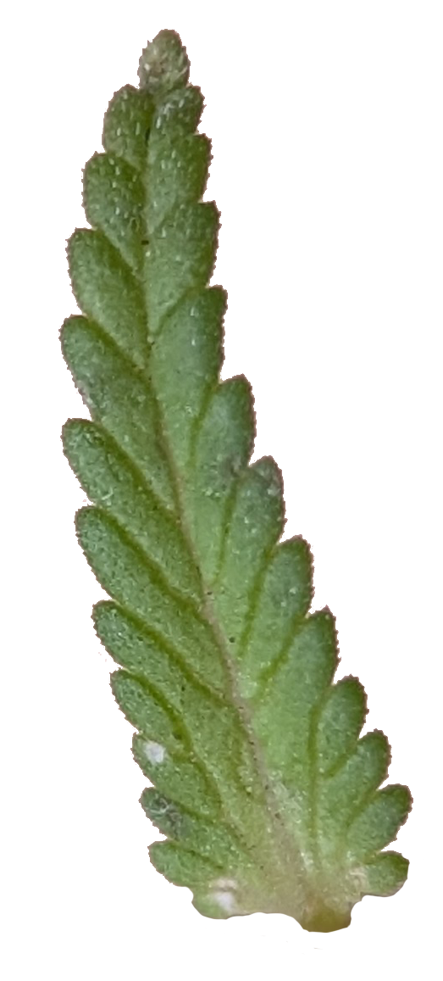
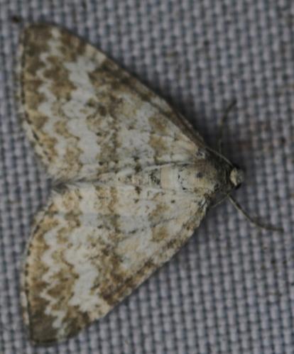
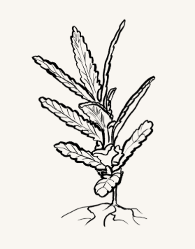
Yellow rattle
Meet the insect
The caterpillar of the Grass Rivulet moth heavily relies on the ripening seeds of Yellow rattle.
Fun fact
Known as the 'meadow maker' because it is a semi-parasitic plant that feeds off grass roots.
It gets the name 'rattle' from its tiny seeds which make a distinctive rattle when moved.

Slide 28
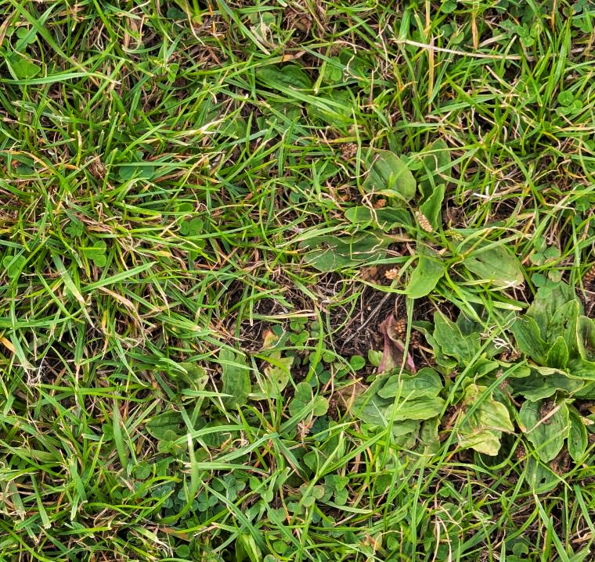
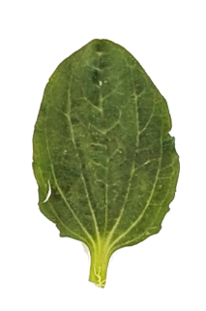
What percentage of this quadrat has greater plantain?

Slide 29
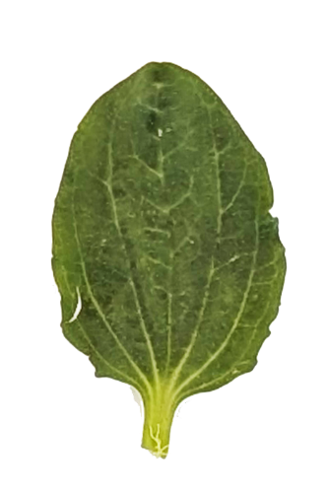
What percentage of this quadrat has greater plantain?

Slide 30

Just over one third (33%) of this square is covered in greater plantain.
This means Greater plantain would go in the 34-50% category.

Slide 31
When we come back inside
We will:
enter the results of our survey online on the Nature Park website
start to think about what our results mean
think about where else at school we could do this survey and different things we can investigate e.g. results before and after we let the grass in an area grow long

Slide 32
What happens with the data
we can use our results to find much more about grassy areas at school as we discussed earlier
it will be combined with all the other Grassland Plant Surveys carried out across England in other schools to answer questions about grasslands nationally
it will be made available to other schools and researchers who can study it and use it in their learning

